Slide 1
CAP7005E: Handling of Scientific and Technical Information Week 2 – prior reading: Search by citation
Fall 2023
Notes:
Hello everybody!
We added comments to this presentation to enrich it, like we would have done in class.

Slide 2
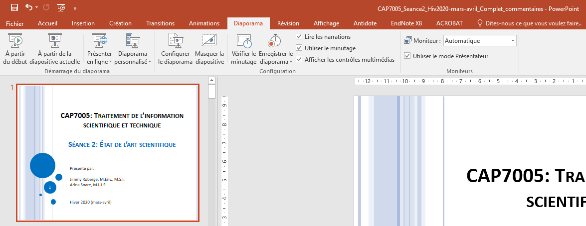
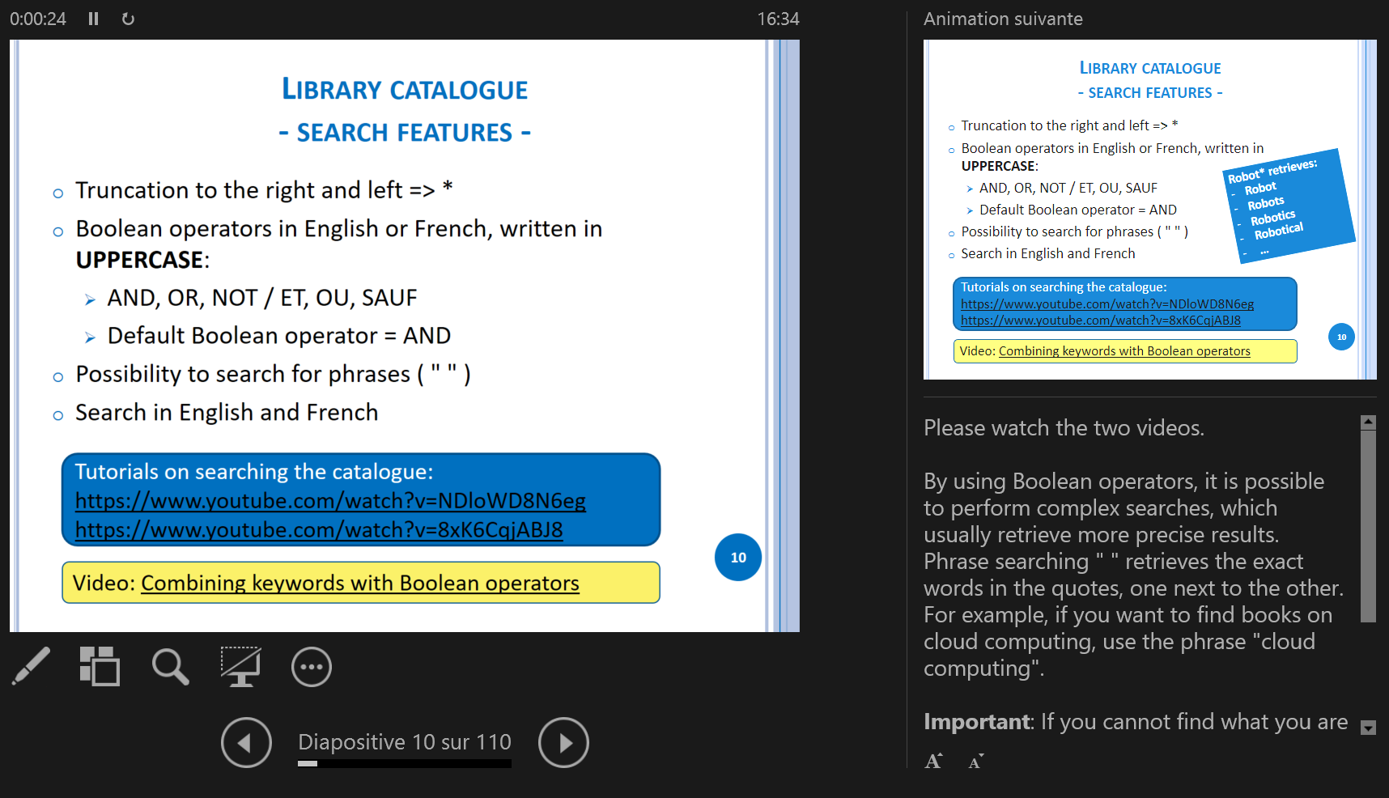
For an optimal experience: Presenter View
Press Alt+F5 to view the slideshow in presenter view (on some laptops, use Alt+Fn+F5).
The Presenter View allows you to follow the presentation with functional links and to view comments at the same time.

Slide 3
Objectives
Learn about the main methods and resources to find scientific information
Perform a cited reference search
3
Notes:
Searching by citation is one of the main methods for finding scientific information. You will learn about Google Scholar and Web of Science and how to use them to perform a cited reference search.

Slide 4
Search by Citation
From an Existing Bibliography
Document Search Methods
‘‘Classical Method’’
Search by Author
4
Notes:
In the previous annotated presentation, you learned how to find documents mentioned in bibliographies. The second method is the search by citation.

Slide 5
Search by Citation
(Cited Reference Search)
Article of interest
(2010)
Includes references to…
Is cited by…
Past articles
(≤ 2010)
Newer articles
(≥ 2010)
5
Notes:
When you find a really good article, you should consult its references to find more articles on the same or a related topic, and you should see what articles cite it.
Articles that cite an important article to your research usually discuss the same topic or a related one.
Looking at how these articles cite one another, you will notice the developments regarding your topic. You can discover the "aftermath" of an article, such as who commented on it or who criticized it and why.
A cited article is generally considered to have had some impact in its field. The number of citations often depends on the field, i.e. different fields have different citation practices. There are areas where scientists do not cite a lot, such as mathematics and there are fields such as biomedical engineering where each article has scores of references.
A recent article will not immediately be cited and some articles will never be cited.
We will also discuss citation alerts and we strongly recommend that you set them up to keep you informed of developments in your field.
For example, for an article published in 2010:
the references included in this article were published before and in 2010;
the citations to this article were published in 2010 and after.

Slide 6
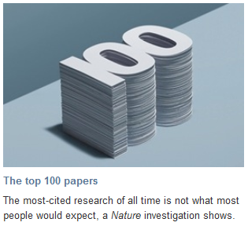
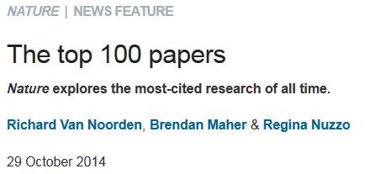
More citations = Better article?
A higher number of citations usually indicates a greater impact.
Many of the most cited articles explain a methodology.
doi:10.1038/514550a
Notes:
The number of citations is not an absolute measure of the quality of an article. For example, consider the publication date of an article: if it was published within the last year, there will probably be no citations or only a few citations to it, but this does not necessarily mean that it is not a good article.
Although it was published in 2014, the Nature article mentioned in this slide still explains very well that some major discoveries are quickly included in books or encyclopaedias and thus the original paper is no longer cited.
The most cited article in Web of Science has more than 300,000 citations and explains a method for quantifying proteins―a method that is widely used in biochemistry. The researchers using this method therefore cite this article published in 1951.
Note that citation practices vary from one field to the other. For example, in biomedical engineering the authors usually cite more than in mathematics.

Slide 7
Where to find citations
Answer to a question from the self-diagnostic test:
These resources allow searching by citation:
Google Scholar
Web of Science
Scopus***
***We do not subscribe to Scopus!

Slide 8
Exercise 1a
Using Google Scholar (scholar.google.ca), find this article:
Perrier, N., Langevin, A., & Campbell, J. F. (2006). A survey of models and algorithms for winter road maintenance. Part I: System design for spreading and plowing. Computers and Operations Research, 33(1), 209-238.
How many times was it cited?

Slide 9
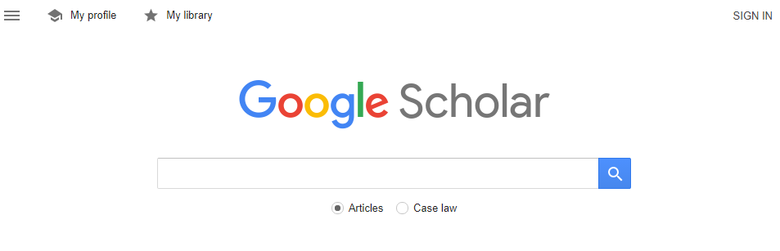
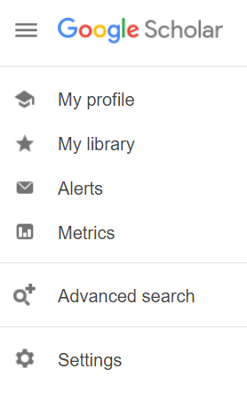
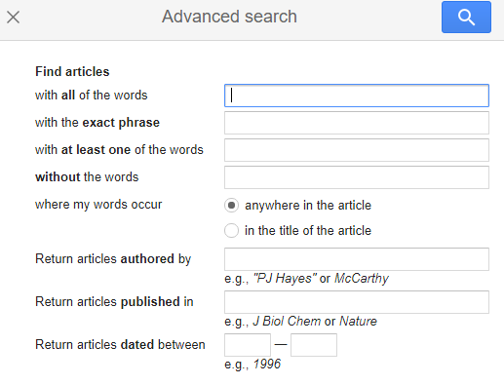
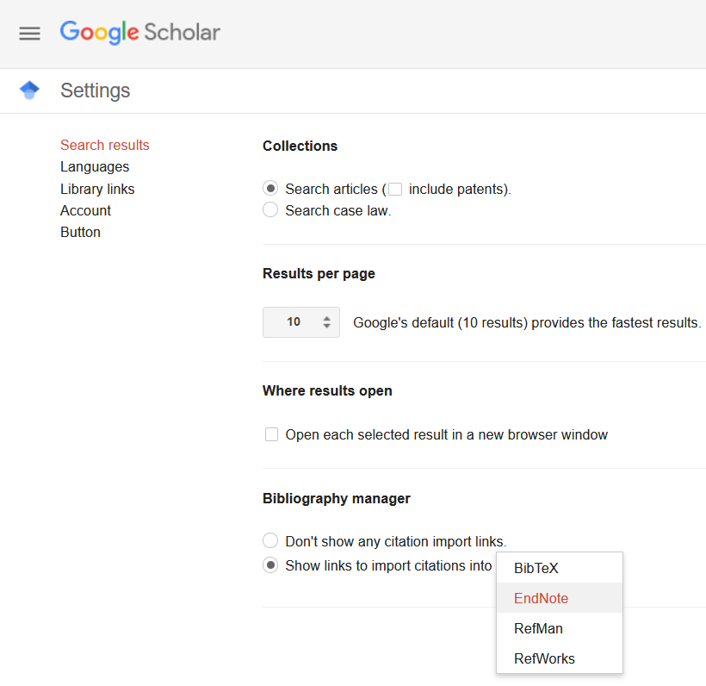
Notes:
"Google Scholar includes journal and conference papers, theses and dissertations, academic books, pre-prints, abstracts, technical reports and other scholarly literature from all broad areas of research. You'll find works from a wide variety of academic publishers, professional societies and university repositories, as well as scholarly articles available anywhere across the web. Google Scholar also includes court opinions and patents." Source: https://scholar.google.fr/intl/en/scholar/help.html#coverage
Attention! If you want to perform an exhaustive search on a topic, it is not recommended or sufficient to search in Google Scholar. You should favour the recommended databases in your field.
An advanced search is available in Google Scholar, but it has way fewer options than specialized databases such as Compendex and Inspec.
Google Scholar can be set up to export towards EndNote or in .bib format (BibTeX), but only one reference at a time. The Import into EndNote option will appear below each search result.
Attention! We do not recommend that you create bibliographic reference libraries by importing from Google Scholar, because these references will be incomplete. Preferably, import them from specialized databases.

Slide 10
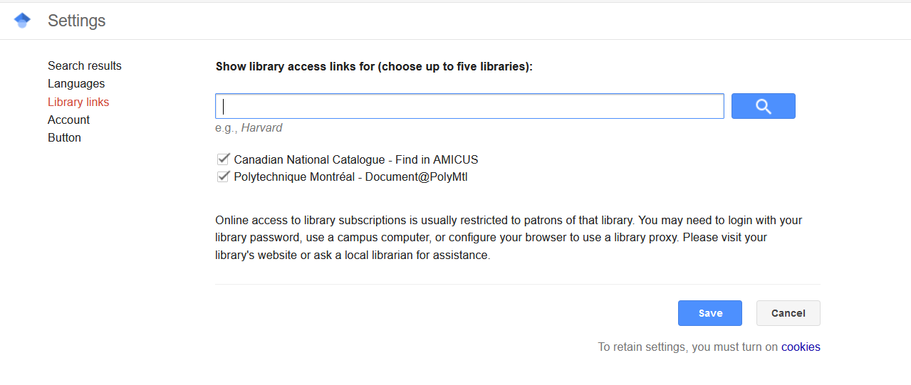
Link Google Scholar to the Polytechnique Library
Notes:
Go to Settings, then Library Links:
Write “Polytechnique Montréal” in the search box, click search, and check this option to display Document@PolyMtl next to the results.

Slide 11
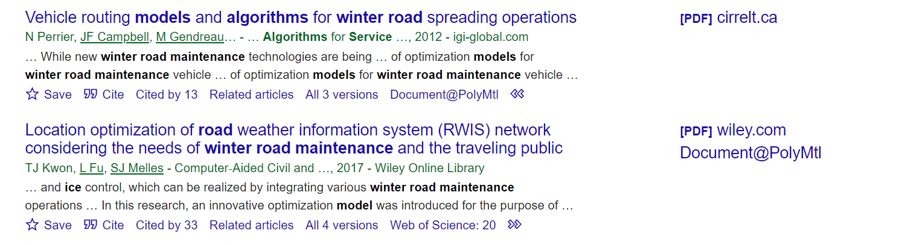
Document@PolyMTL Button
The Document@PolyMtl button can appear in one of two places in Google Scholar. The link will direct you to the document at the Library (the button appears because of the Google Scholar settings option, Library Links seen in the preceding slide).
To access this link, click on the arrows (<< ) to see all the links associated with the reference.

Slide 12
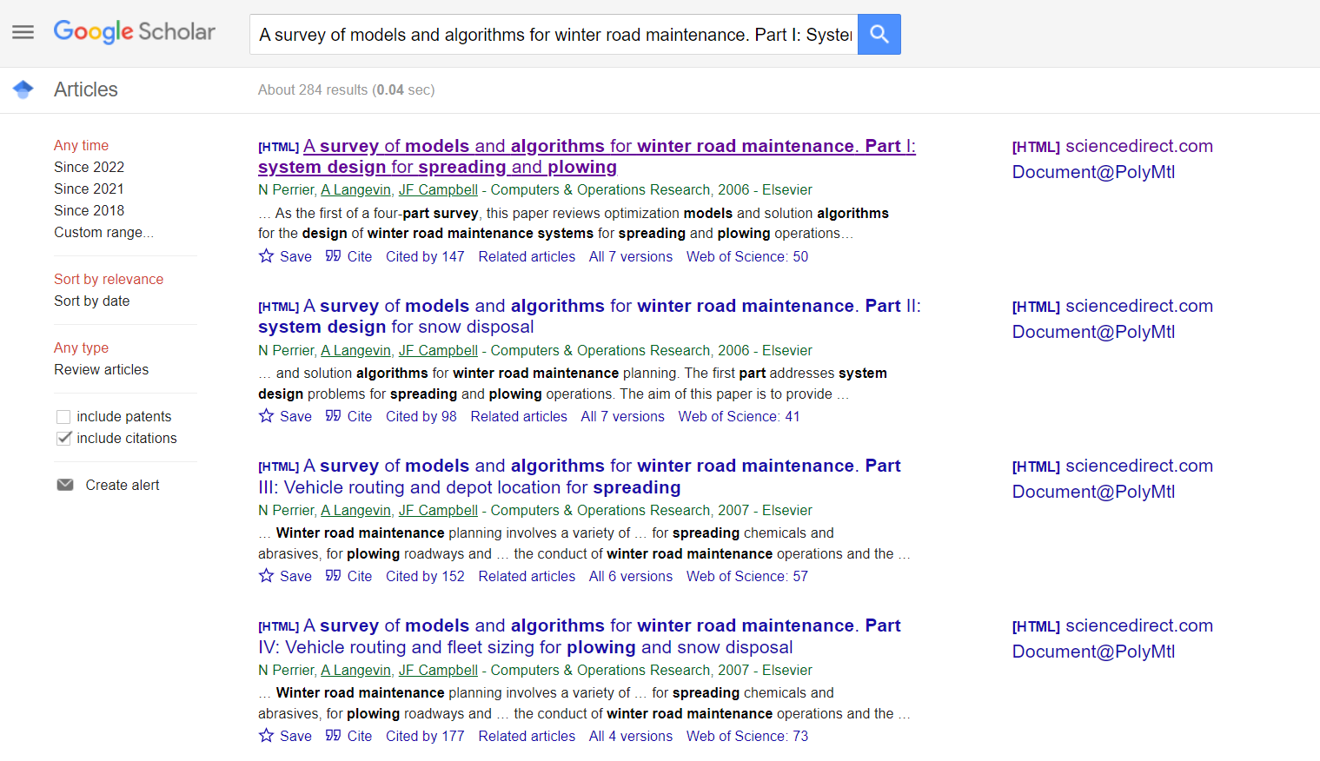
By clicking the title, the abstract or the full text of the article, if available, will be displayed.
Click here to download the reference in the EndNote file format (.ris) or BibTeX.
Search performed on September 15, 2022
Notes:
This is a four-part article. Note that when looking for a specific title (A survey of models and algorithms for winter road maintenance. Part I: System design for spreading and plowing) we find nearly 300 results!
Here, if you click on Create Alert, Google Scholar will create an alert that includes the keywords in the title and not a citation alert.
Document@PolyMtl links Google Scholar to the Library subscriptions, i.e. it leads to the full text of the document if the Library has a subscription to that journal or, if not, leads to the interlibrary loan form.
Click on the link « All X versions » to view a list of the different versions of the article available on GoogleScholar. These lists sometimes include Open Access and manuscript versions of documents, which you can consult without a Library subscription.
The number of citations to the same article is lower in Web of Science. There are several factors that may explain this, such as the fact that Web of Science rigorously selects the journals it indexes. In addition, Google Scholar includes many more conferences. Google also lists books, which Web of Science does not. Be aware that the information in Google Scholar can be of poor quality and can include duplicates and false citations. There is no content control in Google Scholar and it is very difficult to report errors.

Slide 13
Limits the search to the most recent years.
Provides a list of articles published by the same author and/or that share the same keywords.
Provides a list of publications that
cite the article: articles, theses, books, reports…
Search performed on September 15, 2022
Notes:
Click on Cited by... to see the documents that cite our article.
Since Google Scholar does not include all scientific literature ("...we index papers, not journals". Source: https://scholar.google.com/intl/fr/scholar/help.html#coverage), the number of citations here is not necessarily the actual number of citations.
Related articles: The Google Scholar help section only states that: "It finds documents similar to the given search result“, but the search results seem to show that the related articles are articles by the same author or which contain the same keywords.

Slide 14
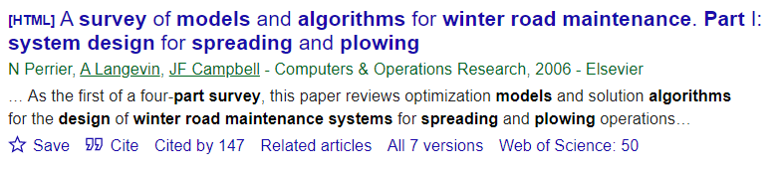


Provides a list of publications that cite this article (articles, theses, books, reports… ):
Search performed on September 15, 2022
Notes:
These documents are not always real citations - see the one published in 1906 (?)!

Slide 15

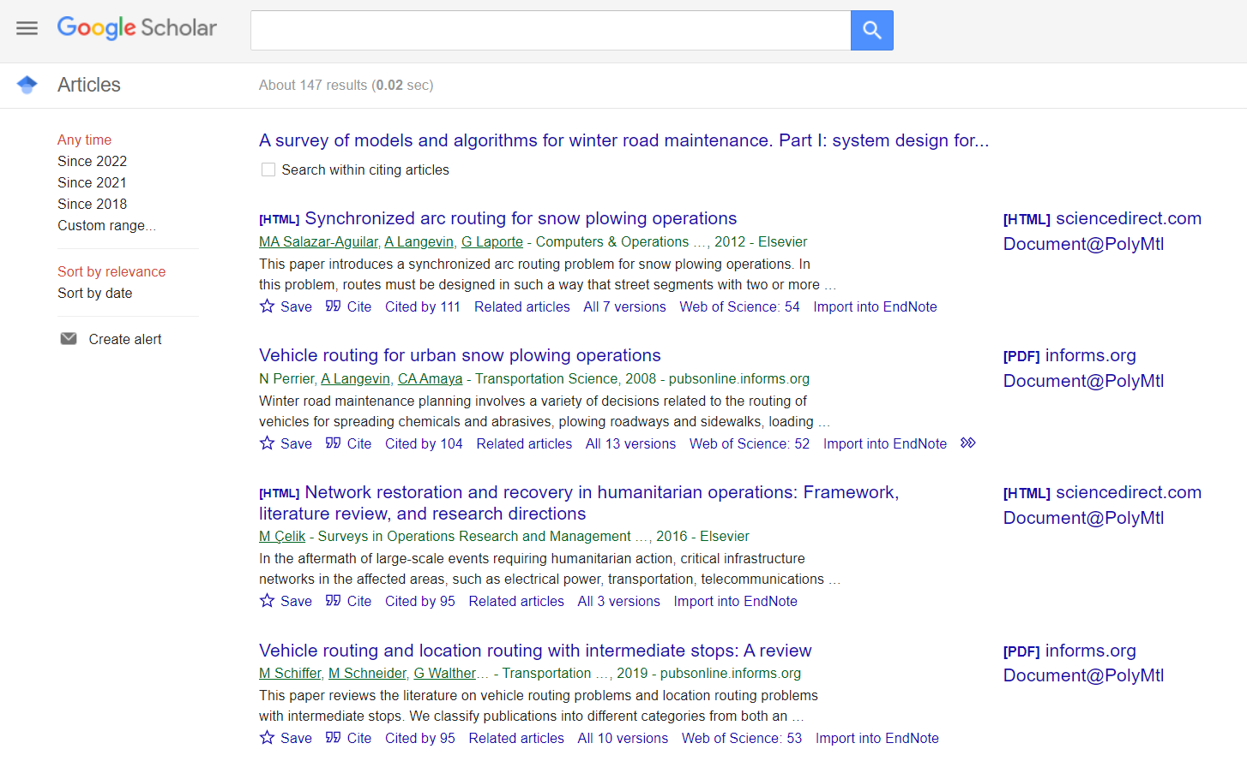
Citation alert in Google Scholar
Display the list of citations by clicking on Cited by... , then click
1
2
15
Notes:
To create a citation alert, click on Cited by… and then on Create Alert.
Google Scholar will ask for your email and you will receive an email each time Google Scholar finds a new article that cites the initial article.

Slide 16
Exercise 1b
In Web of Science, find this article:
Perrier, N., Langevin, A., & Campbell, J. F. (2006). A survey of models and algorithms for winter road maintenance. Part I: System design for spreading and plowing. Computers and Operations Research, 33(1), 209-238.
How many times was it cited?
16
Notes:
Web of Science is recommended for all fields of engineering even though it is not a database specialized in engineering. It is a rigorous and high quality multidisciplinary database that includes documents in engineering, but also in other fields (natural sciences, biomedical field, humanities).
This is the recommended database to query if you want to find out who cited a certain article.
You can find it in the A-Z Databases list (https://libguides.biblio.polymtl.ca/az.php) or under the Journal & Conference Articles tab in your subject guide by field of engineering.

Slide 17
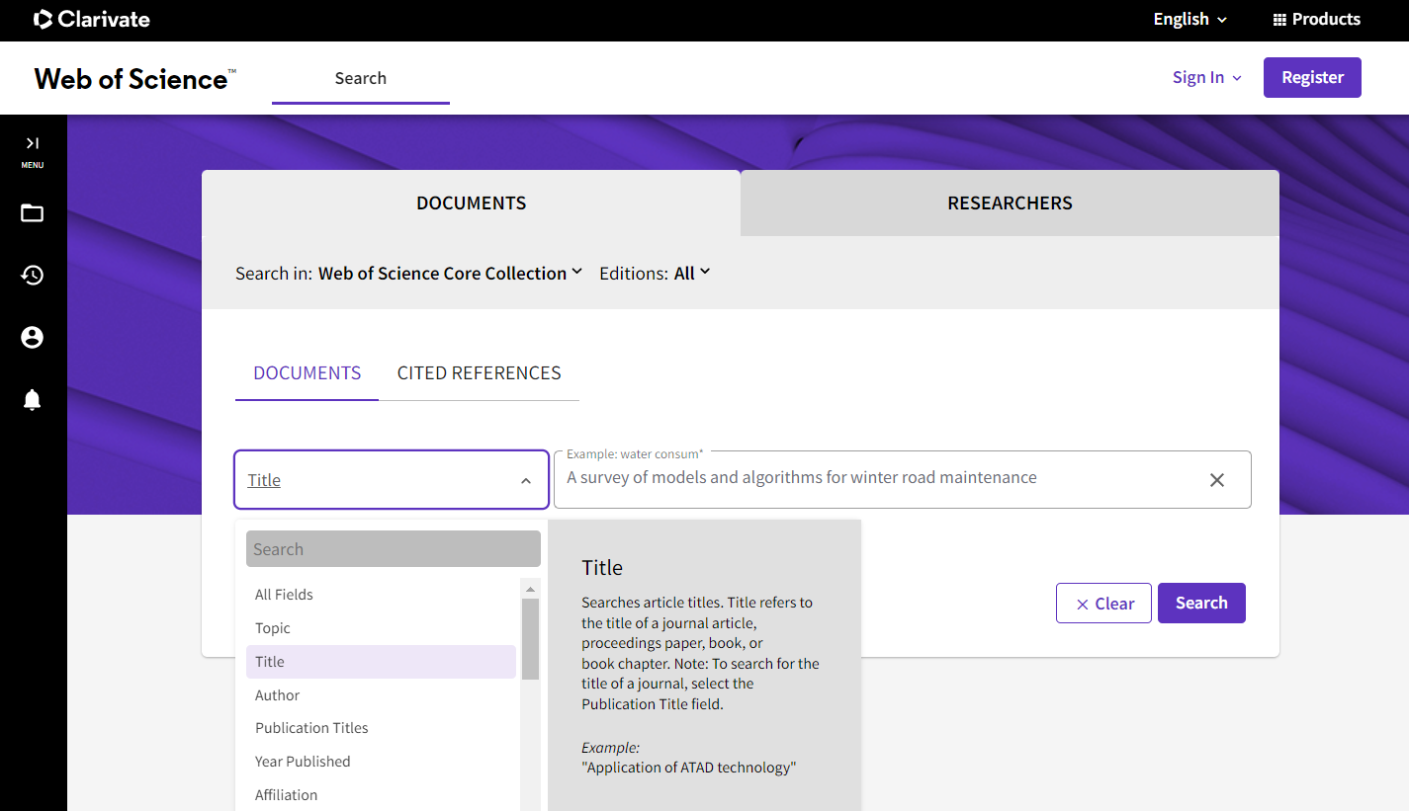
Many search fields are available; choose them according to the information you have. For this exercise, we will search in the field Title.
Notes:
Web of Science Core Collection indexes over 21,800 journals and 300,000 conferences. (Source: https://clarivate.libguides.com/librarianresources/coverage)
There are several fields available to perform a search.

Slide 18
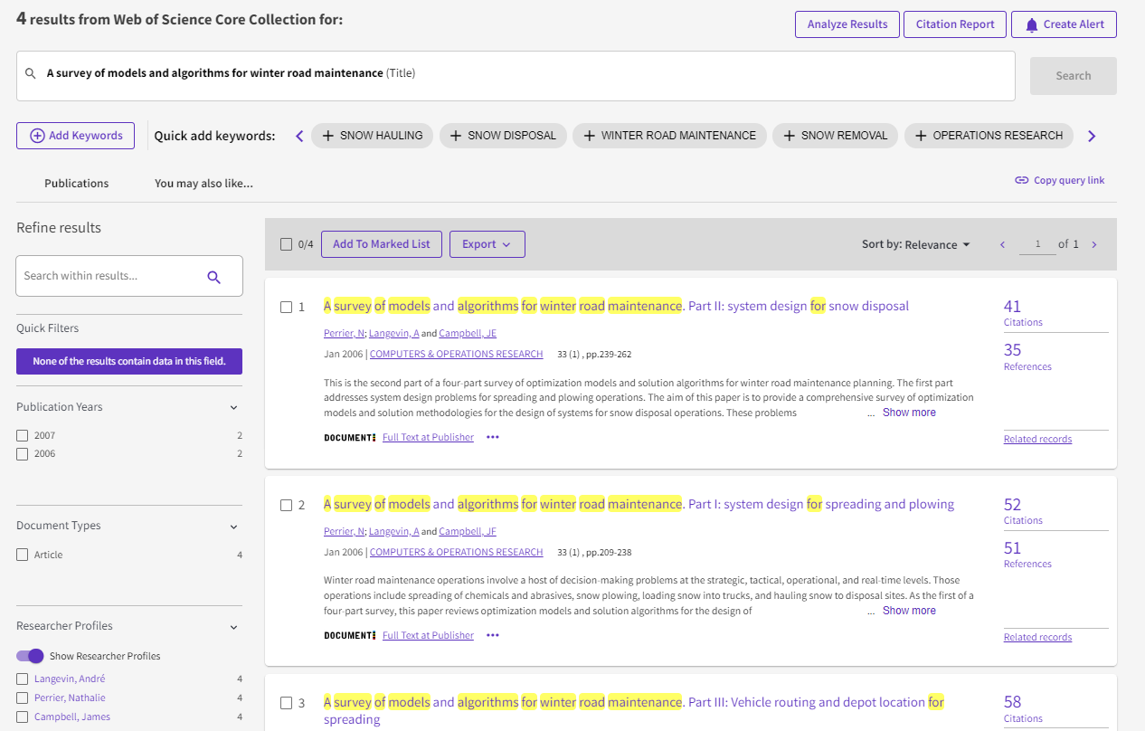
A Page of results in Web of Science
This was a partial title search.
Click on the title you are interested in.
Search performed on September 14, 2023
Notes:
Here, we searched a part of the title (A survey of models and algorithms for winter road maintenance) and we got 4 results, which are the 4 parts of Nathalie Perrier's article.
Click on the Part 1 title to access the detailed reference.
Under Citation Report, you can see more details on the citations to the documents in the results list.

Slide 19
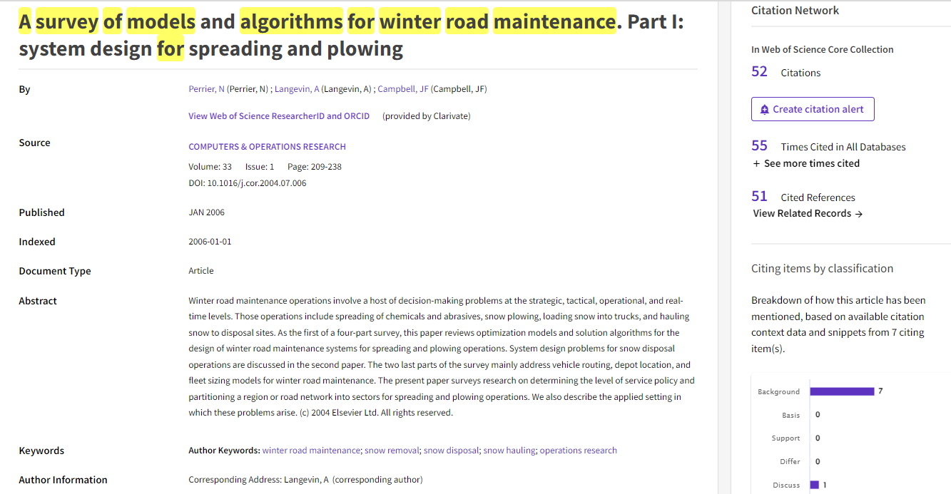
Bibliographic reference in Web of Science
52 articles citing this article.
Create a citation alert and receive an email when new citing articles are added to WoS.
51 References cited
by the author
Articles having
shared references with the displayed article
Search performed on September 14, 2023
Notes:
Click on the number of citations or references to access the lists of citing and cited documents.

Slide 20
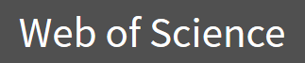
Cited Reference Search in
For finding references, primarily from academic journals, citing a specific author or article.
For finding other authors and institutions working in your field.
Contains tools to analyze results.
Includes links to online tutorials.
20

Slide 21
summary
Google Scholar | Specialized Databases
Useful when you know what you are looking for | Perform a search by topic
Find missing bibliographical information to complete a reference | Allow complex searches
Find conference papers | Reliable and stable body of articles
Perform a cited reference search | Perform a cited reference search in some of them
No list of sources | List the indexed sources (journals)
Few search and filter capabilities | Usually paid subscriptions
Irregular updates | Search interfaces generally not so intuitive
Duplicates and false references | Usually do not include an automatic spelling corrector
Notes:
Here, the advantages are in green and the disadvantages are in red.
Google Scholar is useful to find a document you know (e.g., a given article) or to quickly find some references on a topic, but we do not recommend it for an effective search by topic (there are too many results and not many options to filter them).
In specialized databases, such as Web of Science, it is efficient to search by subject. Also, in Web of Science the citations are more reliable than in Google Scholar, although probably not all citations are listed there, because Web of Science selects its sources.

